Slide 1
Agent and Supervisor Experiences
Janani Ramakrishnan || Product Management
Jerad Cockroft|| Sales Engineering
May ’24

Slide 2
Disclaimer
Some snapshots in this presentation may depict custom widgets which are not available in native Desktop.
Some functionality described here are in development and are subject to changes.

Slide 3
Agenda
Introduction
Customer Experience and Significance of Human agents
Empowering tools for agents
Supervisor tools to support agents
Focus on agent well-being
Call to Action

Slide 4
“Good customer experience helps customers be seen, heard and appreciated. They buy more and they advocate for your brand more.”
Impact on Business
Increased Revenue
“Strong customer experience focus generate 2X times higher revenue growth”
Increased Customer Loyalty
“93% of customers are likely to make repeat purchases with companies that offer excellent customer service”
Reduced Costs
New customer acquisition is 5X to 25X more expensive than to retain an existing one
- Future of CX, PWC

Slide 5
The Five “Rights”
Person
Channel
History
Context
Outcome
Right

Slide 6

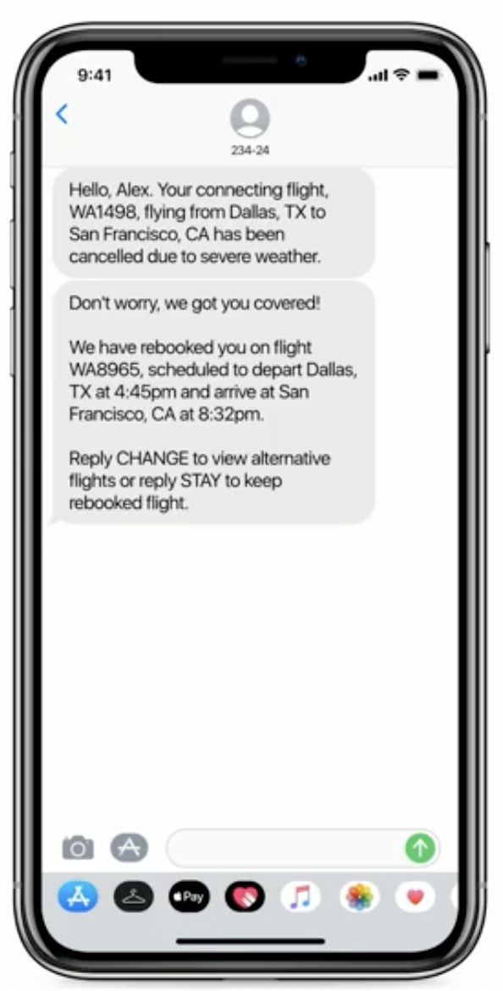
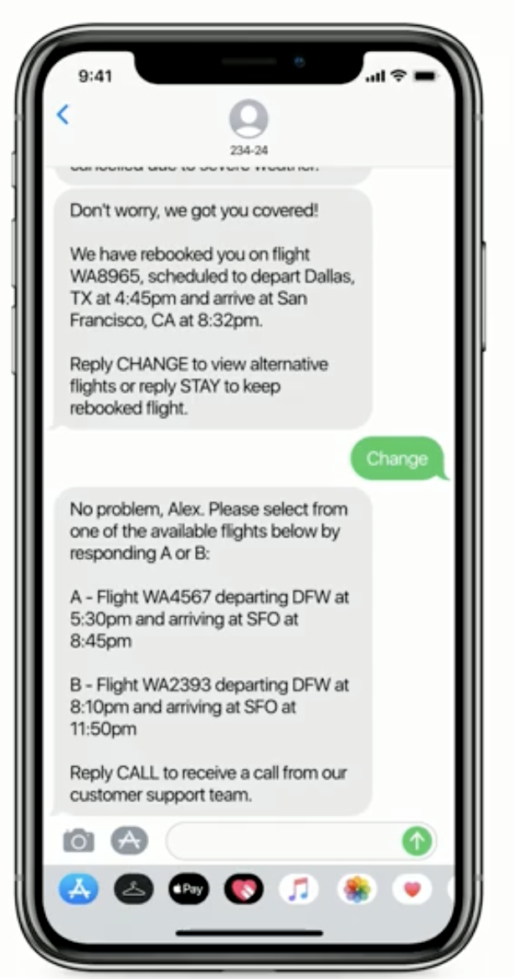
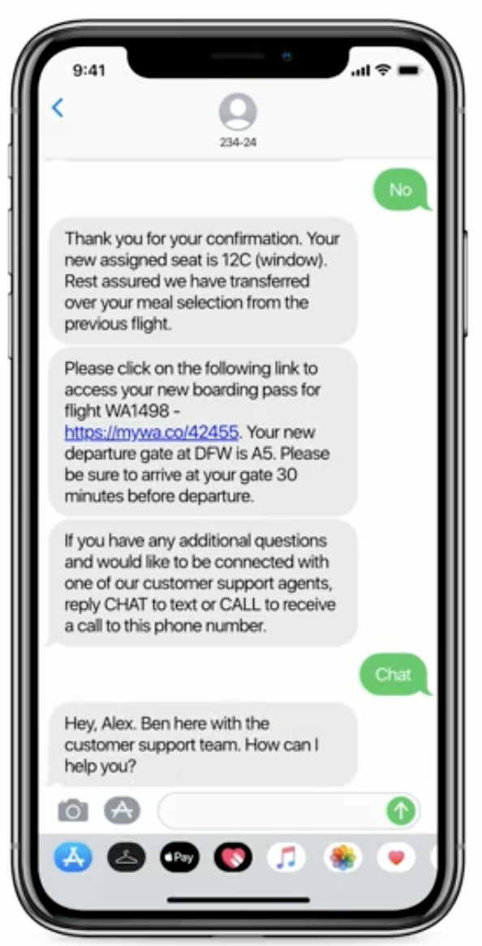
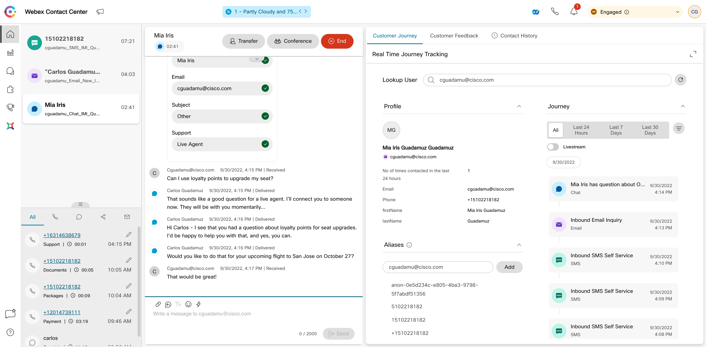
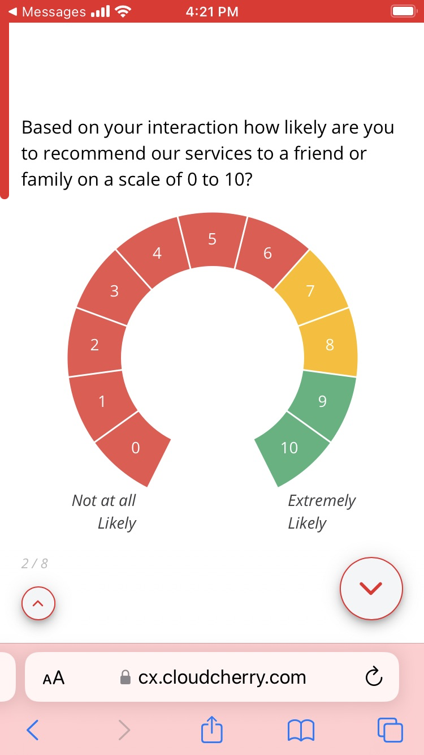
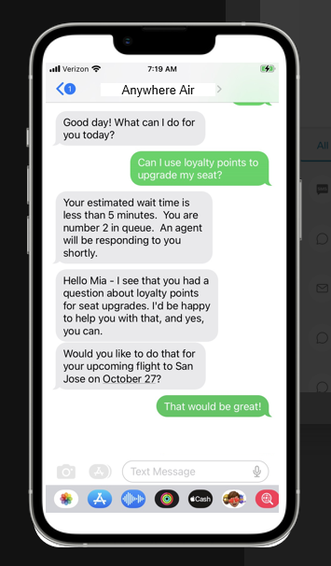
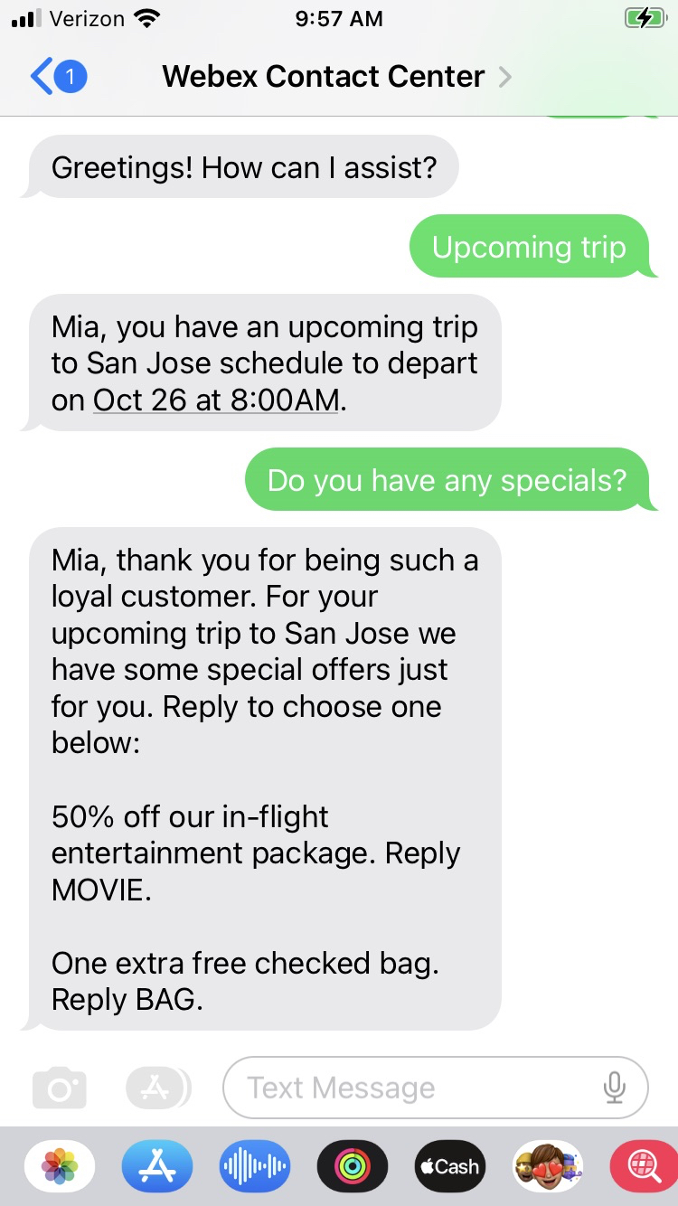
The Customer Journey
Mobile digital automation and self-service
Human engagement
Digital automation follow-up
Proactive notification
Self-service options
Handover to
human agent
Contact Center agent desktop
with full customer context
Experience
survey
Personalized offer
Customer Journey

Slide 7

Even if AI automates contact center workflows, Human Agents are here to stay.
Resolve Complex Inquiries
Show emotional intelligence
Build Deeper Relationships
‘End of Line’ from Automation
Notes:
“10% of all contact center interactions will be automated using AI-powered solutions by 2026, compared to only 2% currently” (Gartner Apr 2023)
Even with advancements in AI and automation, significant portion of customer issues need human agents’ attention. Contact center agent’s role will become more critical. With automation, the complexity of issues that will reach agents will increase. It will require unique skill sets (creatively problem solve, effectively communicate, positively influence), becoming an impactful role. A poor agent experience translates to lost productivity, lost customer, lost money and ultimately lost employee.
According to the International Customer Management Institute (ICMI), engaged and satisfied contact center employees are 8.5x more likely to stay than leave within a year, 16x more likely to refer friends to their company, and 3.3x more likely to feel extremely empowered to resolve customer issues.
Customers only want 3% of their workflows to be automated. So, while from an agent or supervisor’s point of view, automation allows them to focus on more important things, customers continue to seek the human touch.

Slide 8
What agents need to create exceptional customer experiences?
Empowering tools
Supervisors who support them
Care for their own well-being

Slide 9
What agents need to create exceptional customer experiences?
Empowering tools
Supervisors who support them
Care for their own well-being

Slide 10
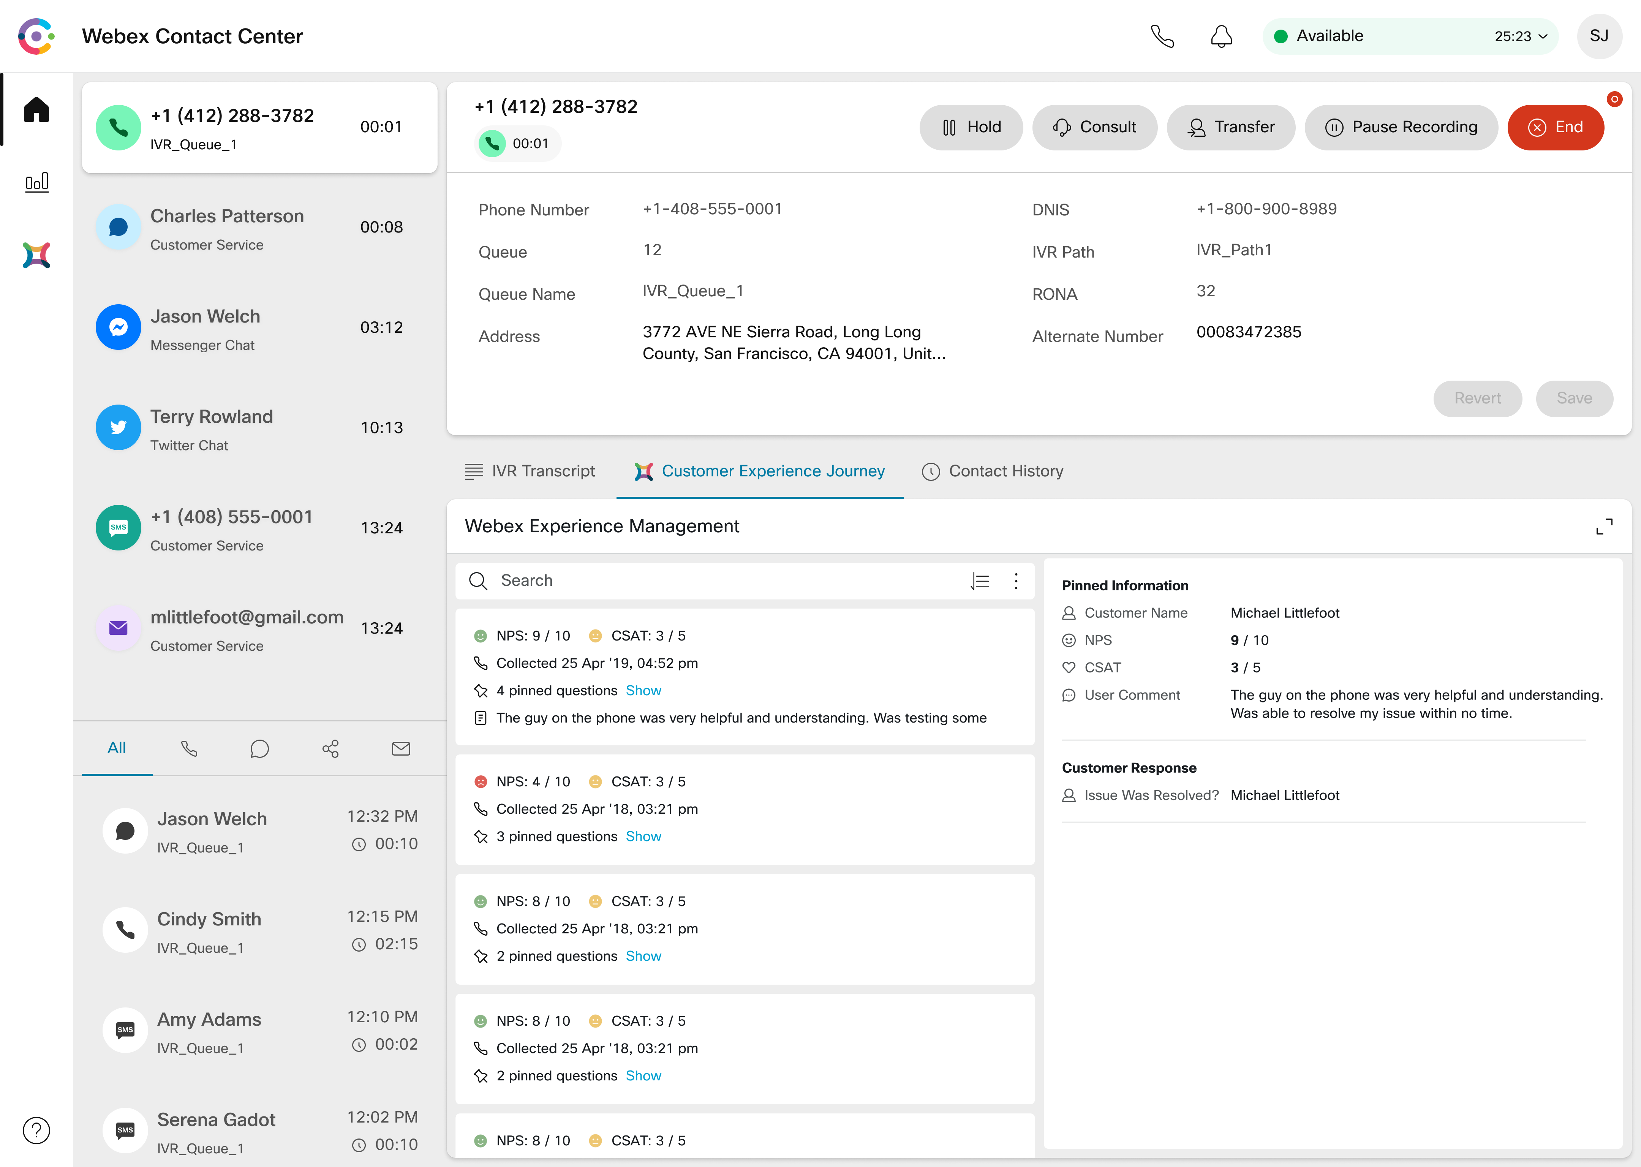
Single interface that gives agents everything they need!
Flexible controls
Reach out to other experts:
Consult/Transfer to agents, queues, dial numbers, and to knowledge workers
Multi-way (up to 6 participants)* conferencing
Omni-channel
Customizable
History
Rich customer context
*Coming Soon
Notes:
Need different screen shot!
Make sure you address the gaps and give context on our approach
We need to put CRM related content in there – Holger will give us salesforce and SNOW and I need to check with Adi about what else is on the roadmap.

Slide 11
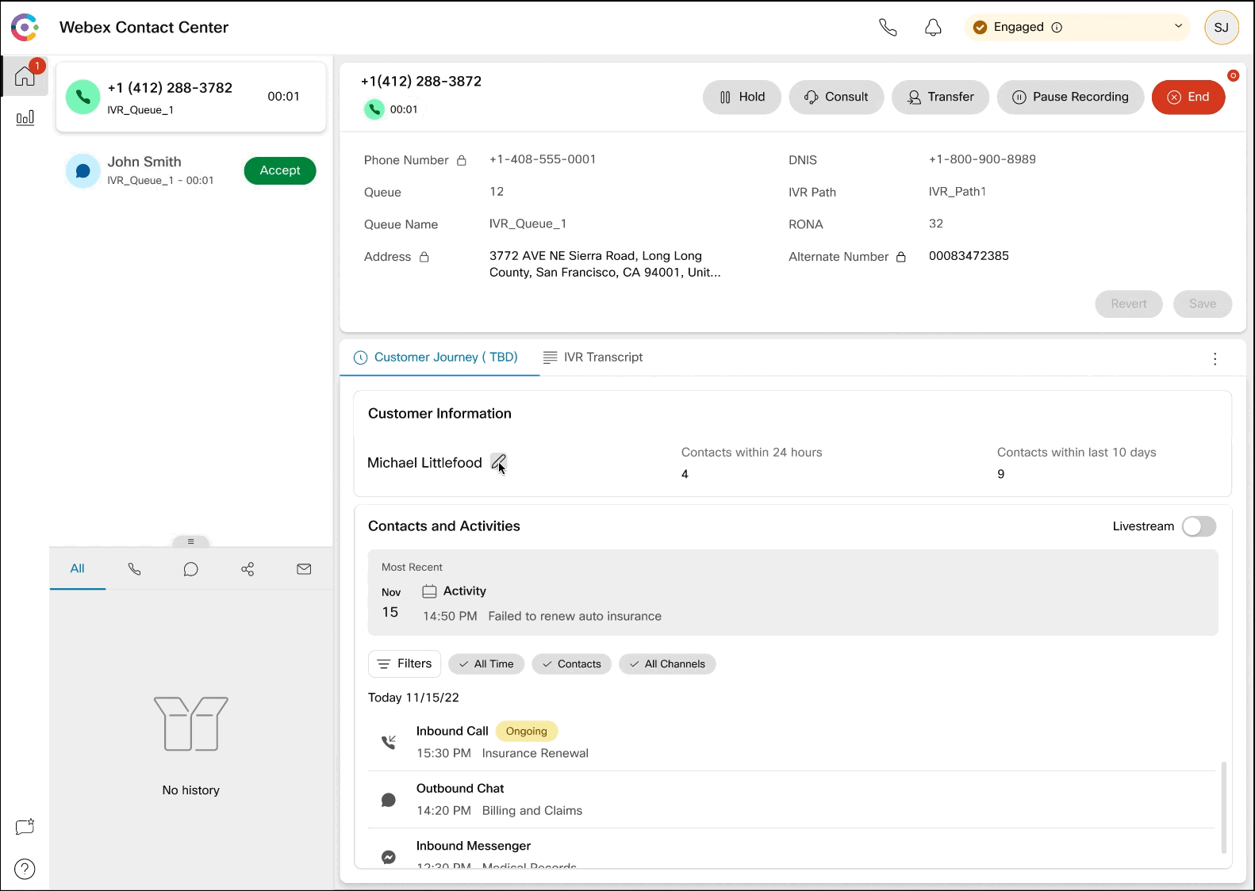
Customer context and history at the agent’s fingertips enables faster agent actions
Customer journey history provides personalized and contextual service
*Limited Availability in the US. Trials in EU starting Q2 CY24
Notes:
With JDS, customers will have access to our APIs that focus on key aspects of the customer journey.
Listen: Integrate with any data source or third-party applications to listen to disparate data sources.
Identify: Create a dynamic customer profile capturing propensity drivers.
Analyze: Apply different aggregation techniques to all customer data collected.
Act: Use the data/insights within JDS to dynamically change the flow within Webex Contact Center Flow Control and personalize the customer

Slide 12
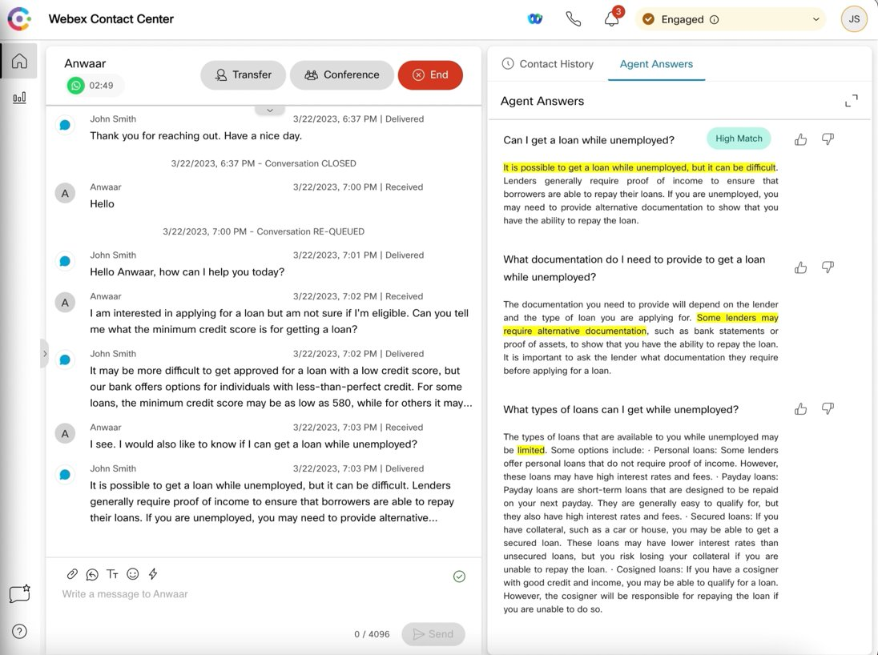
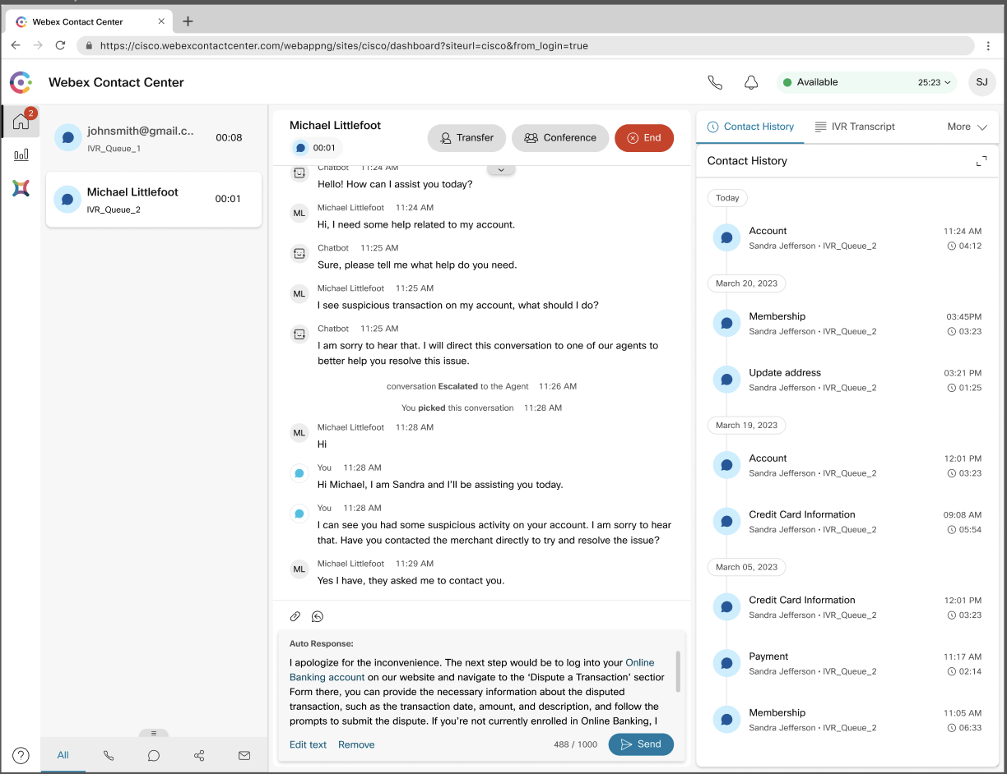
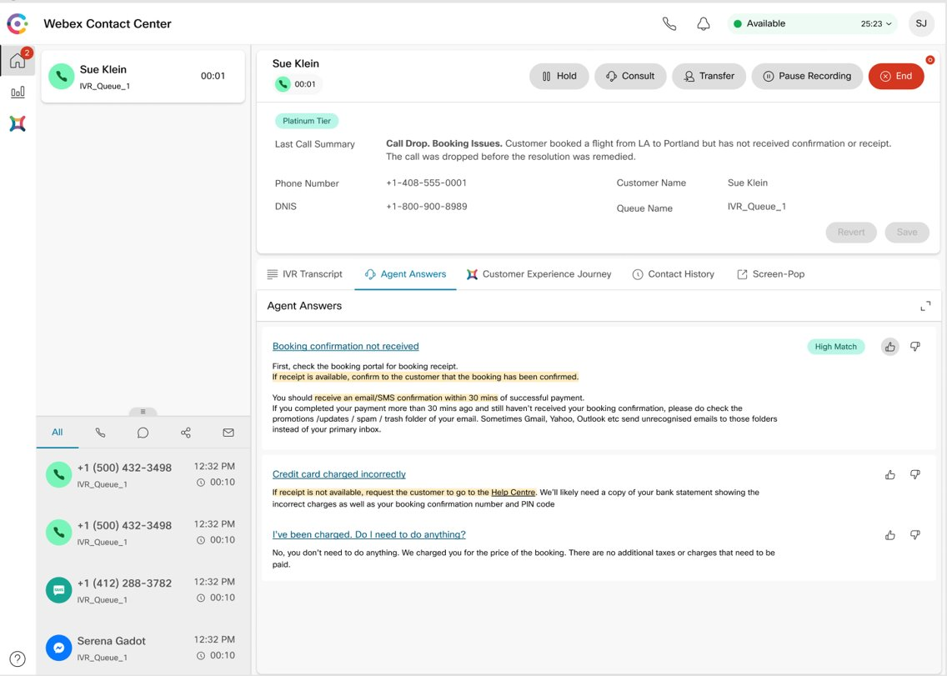
Agent Assistance, Call Summarization powered by AI drives superior agent efficiency and reduces training time
Real-time agent assistance for Digital Channels*
Conversational Assistance*
Agents Answers and Dropped Call Summaries*
Contextual guidance during digital interactions help agents formulate responses quickly.
Automated responses during chat with opportunity for agents to edit enhances response time.
Call summarization eases call back scenarios by providing the second agent all the context they need to resume the conversation
*In Trials

Slide 13
Demo

Slide 14
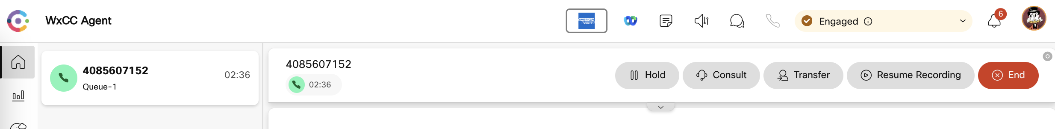


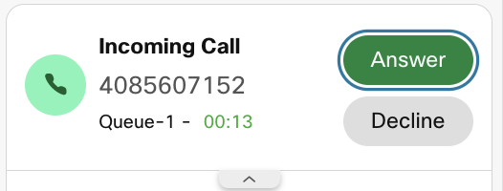
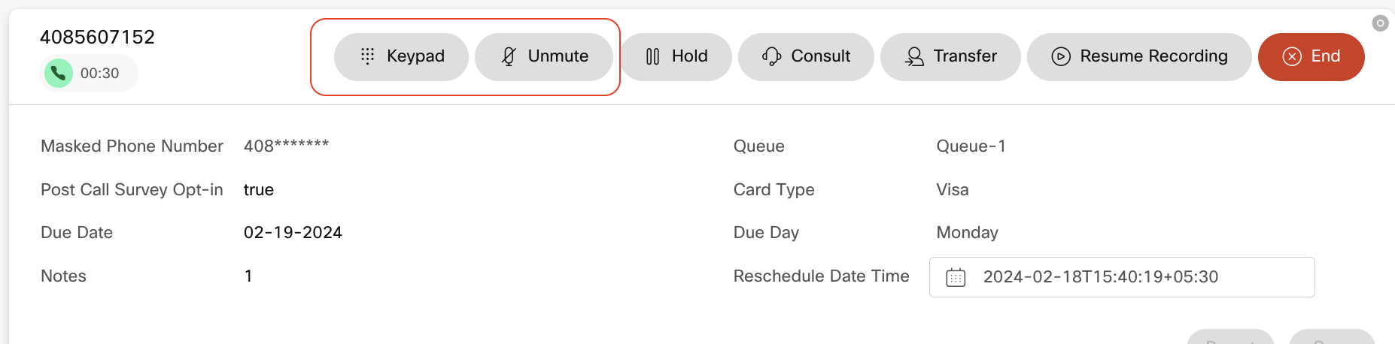
Rich call controls and flexible media options allows agents to engage with customers from where they are
Call controls include consult to dial numbers, queues, agents and even to knowledge workers in collaboration applications.
Bring multiple parties into the conference (up to 6 additional). Allow agents to transfer ownership to a knowledge worker and drop off for handling additional customers. *
WebRTC allows agents to use their web-browser to attend to calls enabling remote work with the need for physical hardware. Currently supported on Google Chrome.
Background noise removal. Currently optimizes for the customer’s voice
*Coming Soon

Slide 15
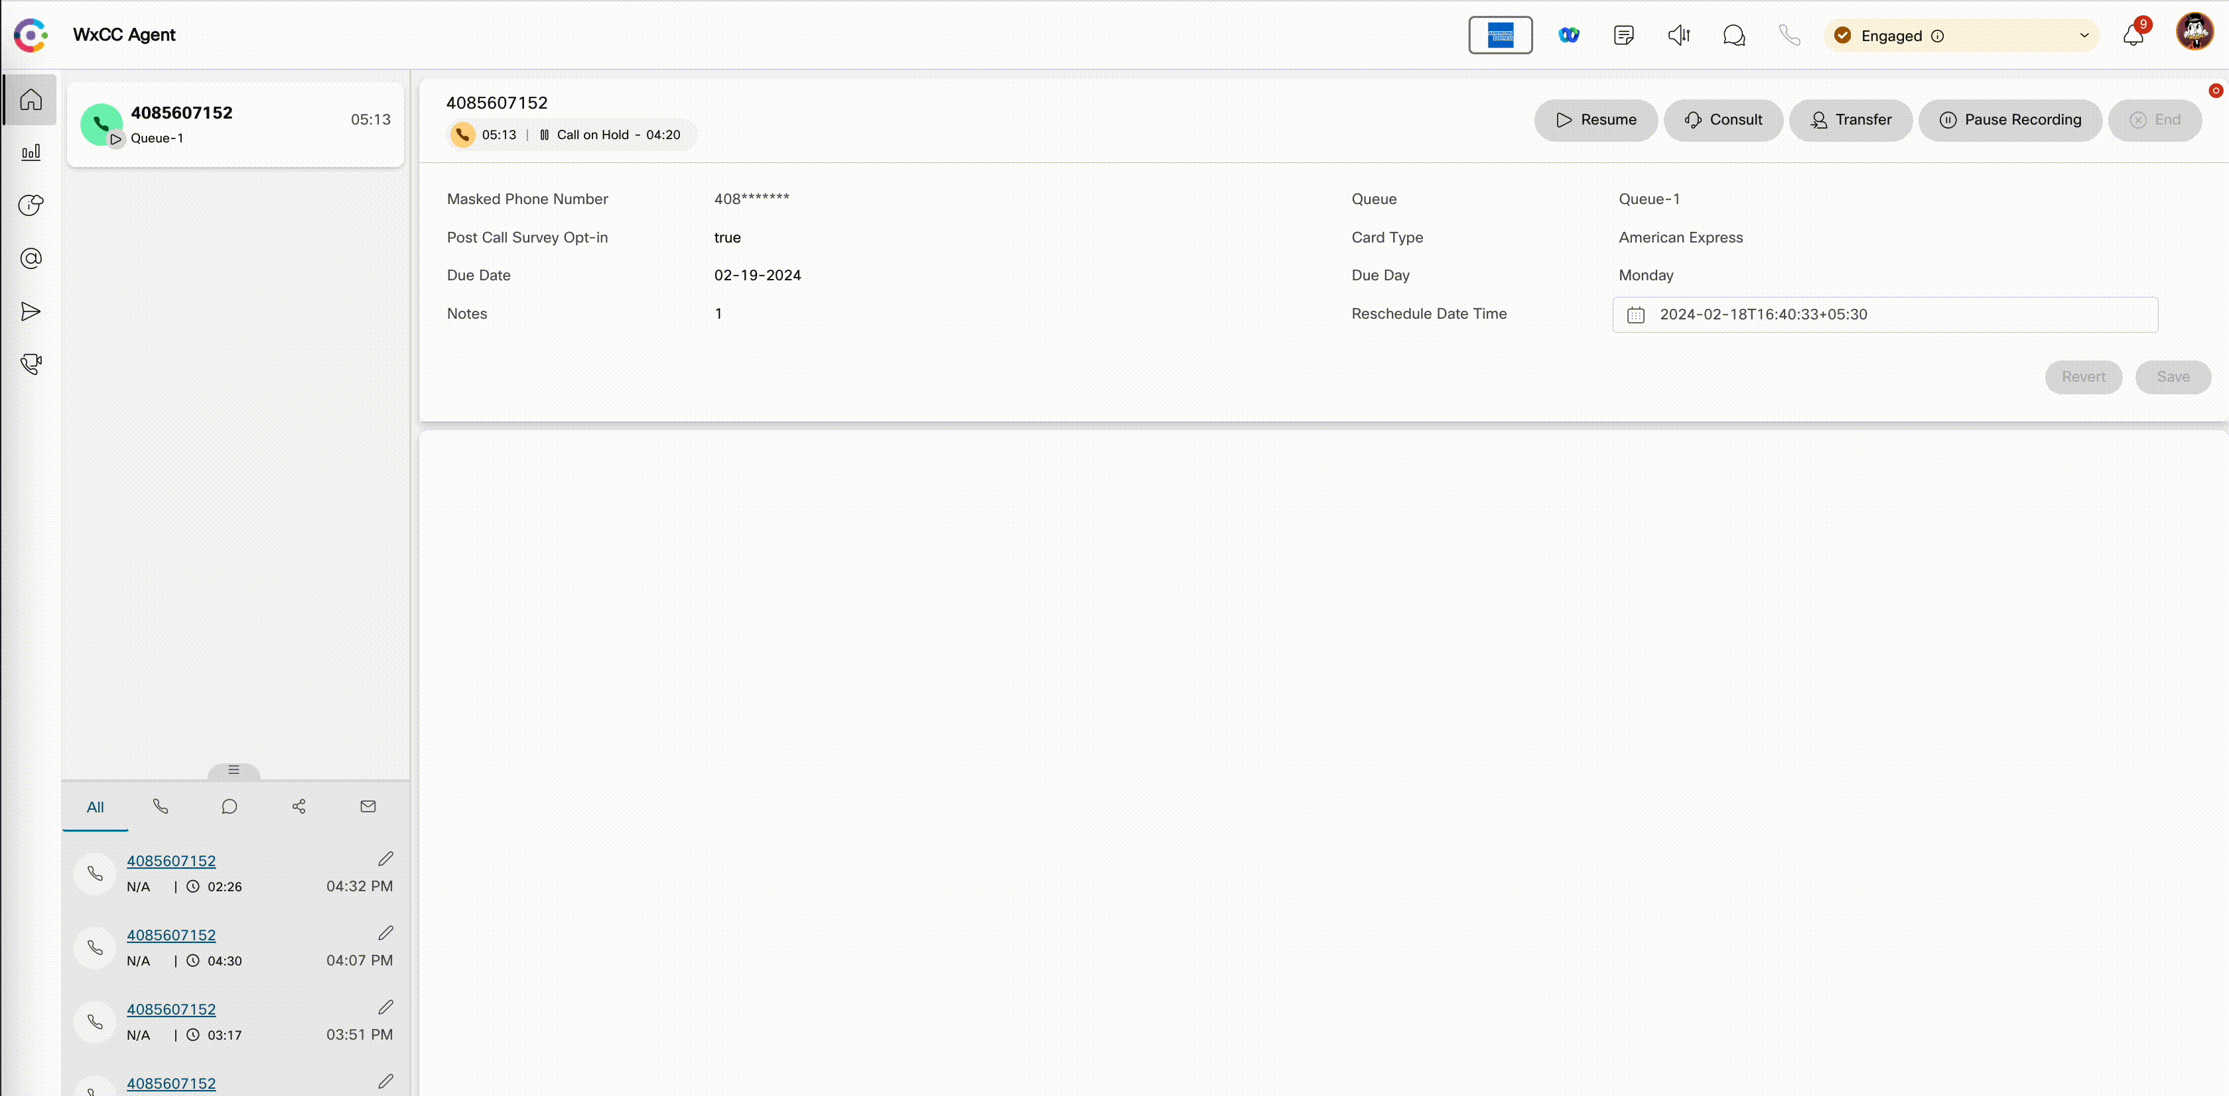
Native integrations with MS Teams brings collaboration and contact center applications closer
Consult Transfer to MS Teams
Agents can connect directly to subject matter experts in their organization.
Agents can understand their availability / presence to connect with them during an ongoing customer interaction.
Search experts by their first name, role, department, or phone number (business phone)
Notes:
Allows routing of skill-based inbound calls from Microsoft phone system to the Contact Center agents.
Supports both Microsoft PSTN and third-party direct routing providers.
Enables the agents to directly handle calls from the Microsoft Teams interface.

Slide 16
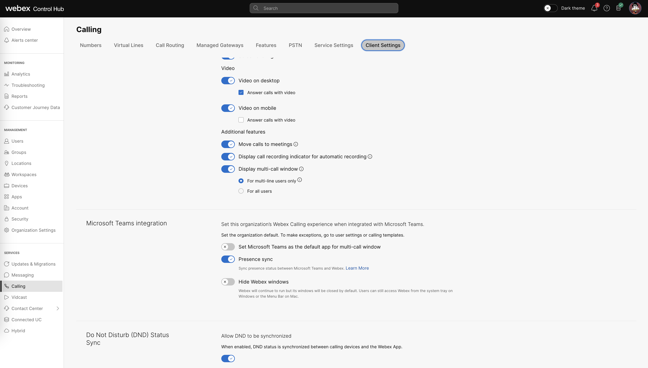
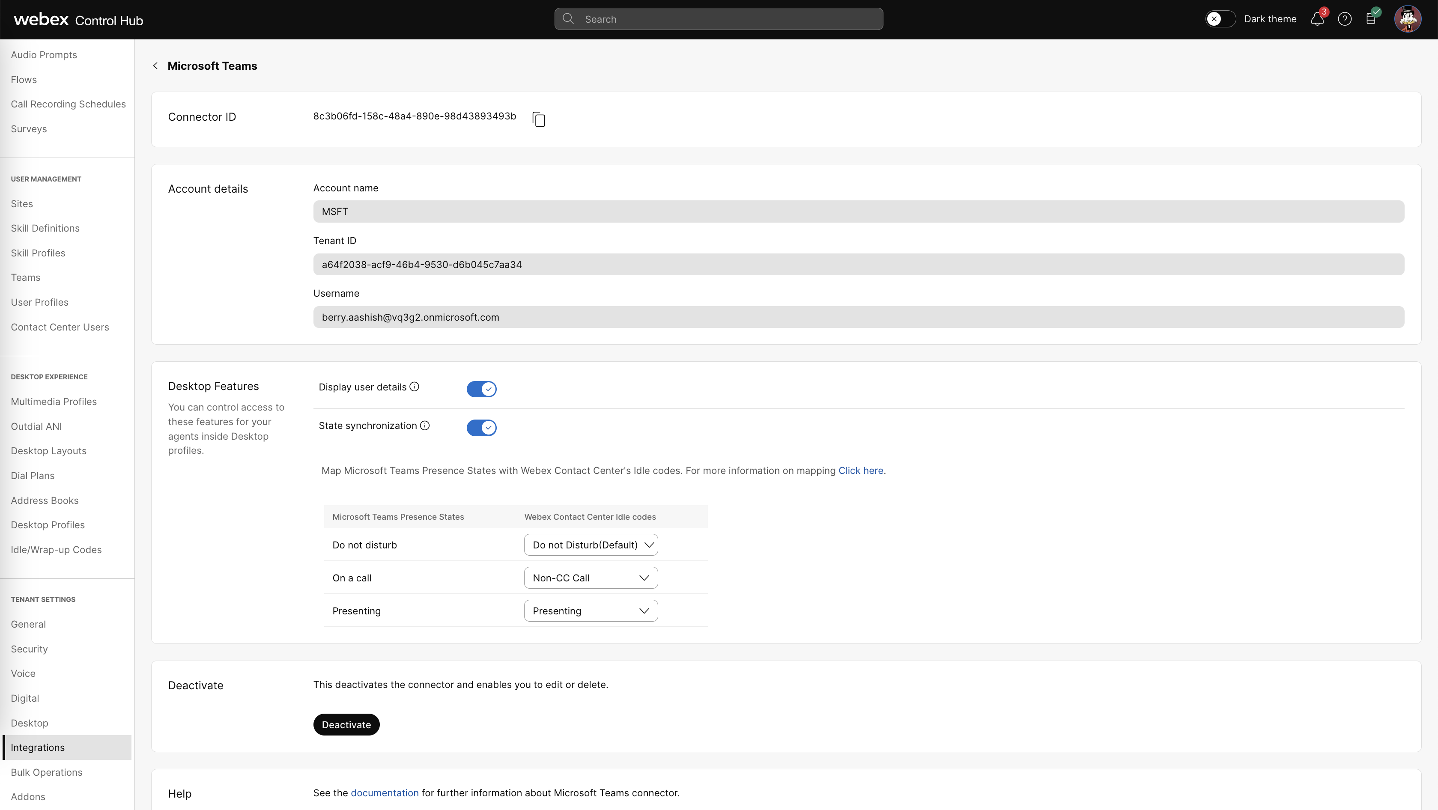
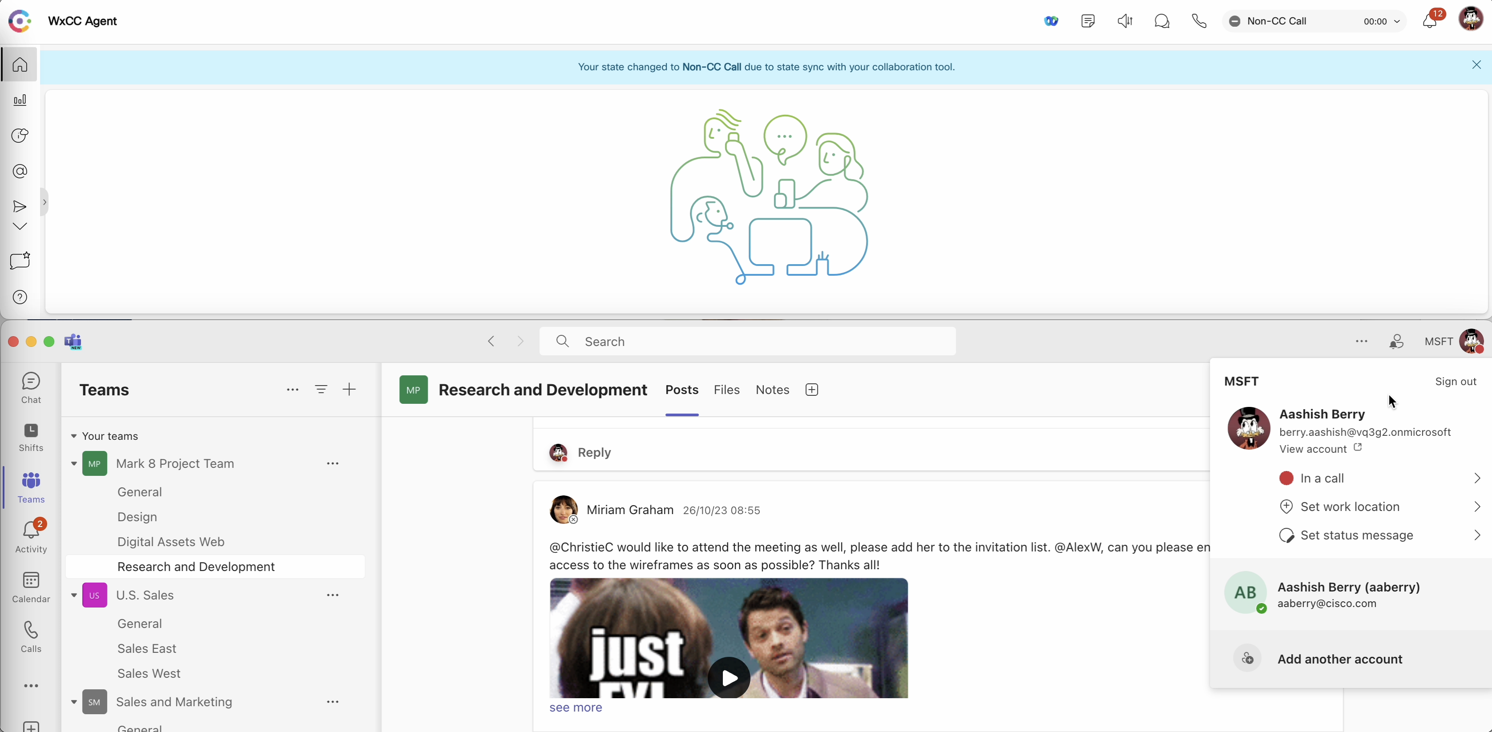
Native integrations with MS Teams brings collaboration and contact center applications closer
Presence sync into MS Teams
2
3
Map the states to Desktop Idle Codes
1
1
Enable Presence Sync on Control Hub
Map the idle codes to states
Presence is integrated across systems

Slide 17
Demo

Slide 18
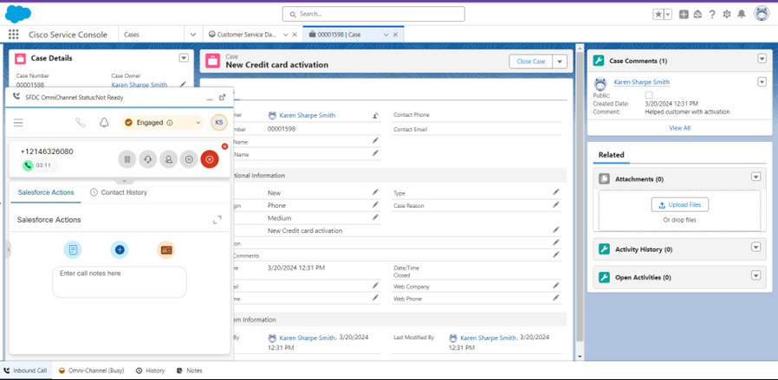
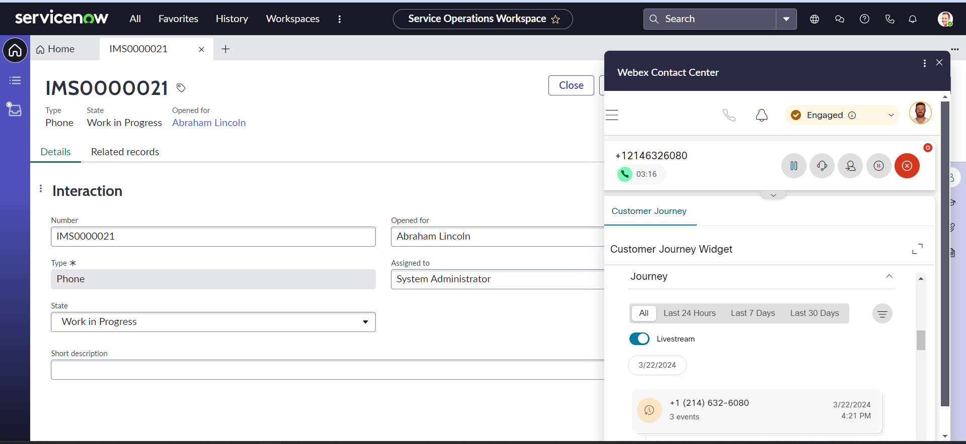
Integrations with popular ITSM and CRM tools allows agents to consolidate the applications they use

Slide 19
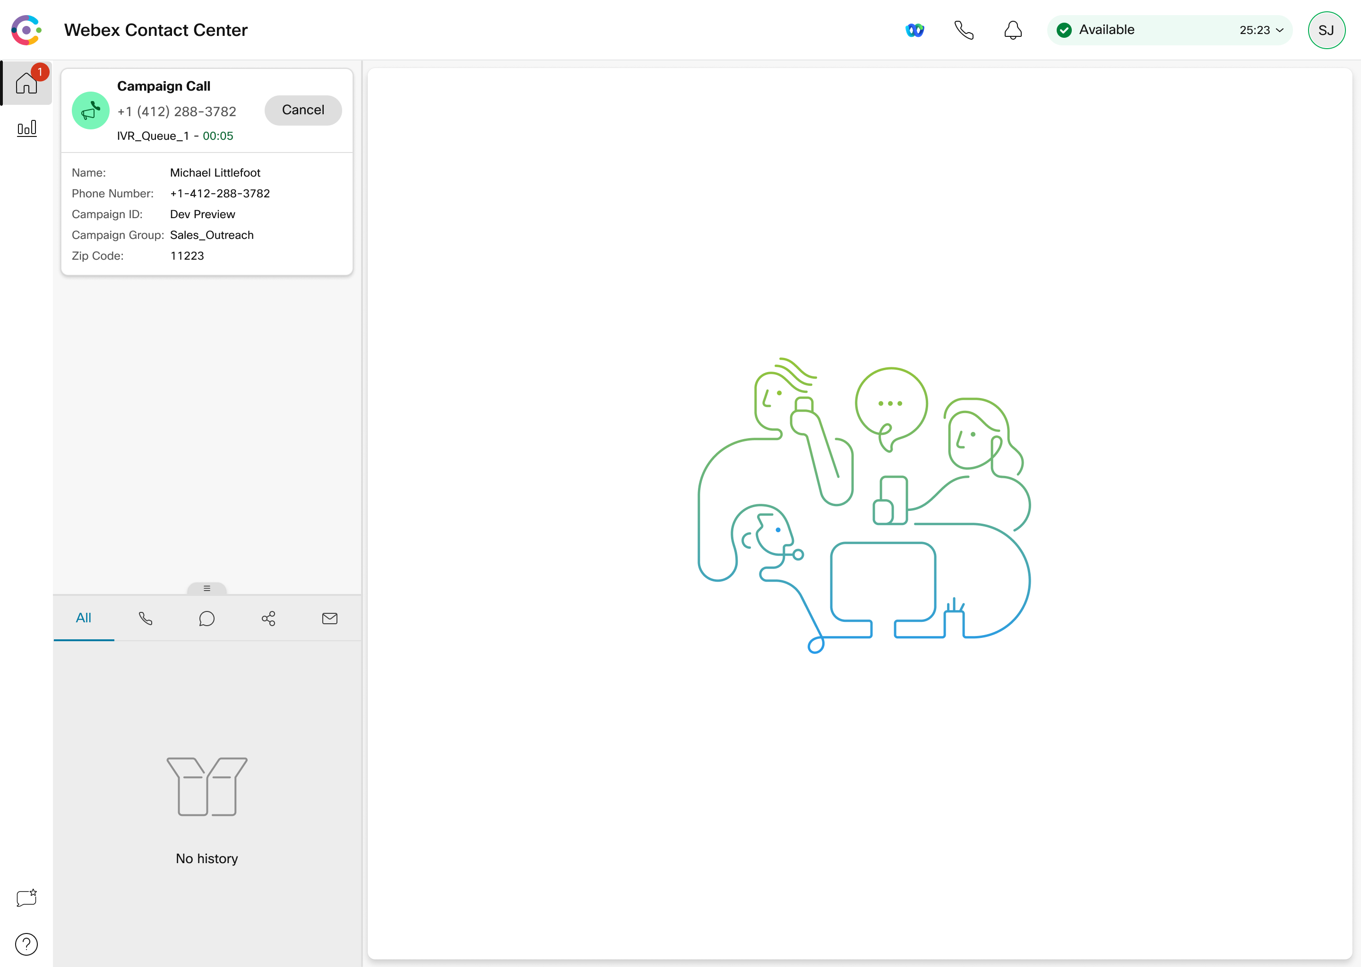
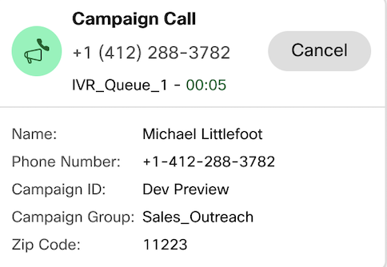
Predictive dialing drives proactive outreach
Progressive Dialing
Dialer dials the contact using a pre-determined pacing mode. Analysis of the media layer is offered.
Predictive Dialing
Allows for automatic adjustment of pacing mode to prevent inadvertent RONA.
Notes:
Preview Campaign: As soon as the agent is made available, there is a phone/campaign icon -> screen shows contact information and dials that contact manually. If they skip calling the contact the 3rd party (Acqueon) will send out another contact
Progressive: The contact is not offered, but the dialer would dial the contact (using the pacing mode setup). The media layer would also do an analysis of the call. Only the live voice is offered to the agent. Call Progress Analysis is done so that busy, fax machine, voicemails are not connected -> maximizes agent efficiency. (Cancel button is not there)
Predictive: Progressive defines pacing mode (you can dial up to 2 contacts for instance). System would configure the abandoned rate and would adjust the pacing mode.
Imagine you have 10 agents, and a pacing mode of 3 -> the dialer places 30 calls. The admin need to be sure of the contact list, they need to develop the confidence on the hit ratio. So, in predictive will help you better configure a pacing ratio to make sure that the configured abandon rate is not reached.

Slide 20
What agents need to create exceptional customer experiences?
Empowering tools
Supervisors who support them
Care for their own well-being

Slide 21
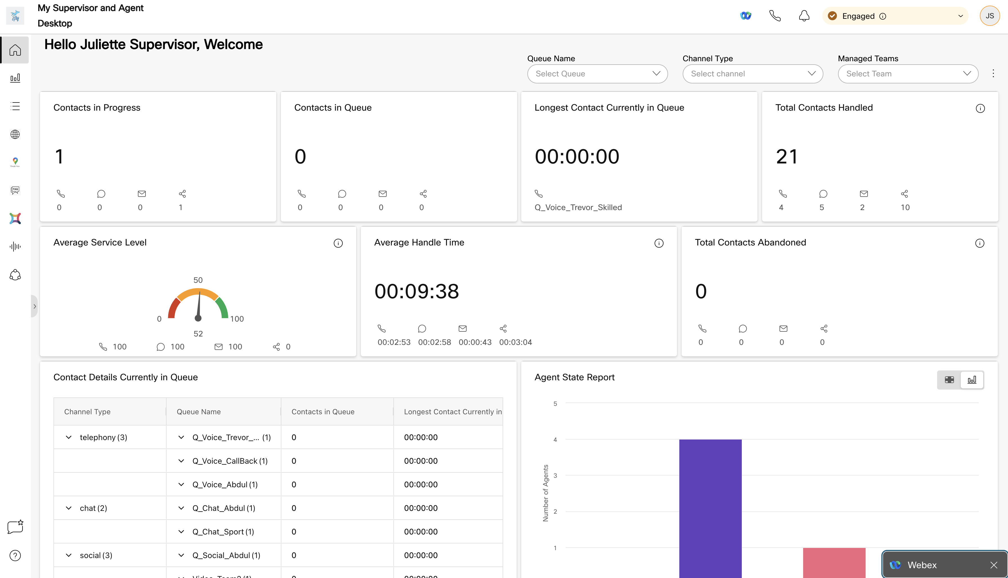
Single pane of glass supervisor cockpit keeps lights on
Role based
Recordings
Real time team metrics
Customizable
Real time queue metrics

Slide 22

…Before Signing in
User should be licensed as ‘Premium – Supervisor’ with NO admin privileges.
Contact Center User configuration should be updated from CH
Supervisor Team should be assigned
User Profile should have essential supervisor modules enabled:
Mid call monitoring
Send messages
Changed agent state
Barge in
Recording access
Notes:
How many of you have tried already the Supervisor desktop?

Slide 23
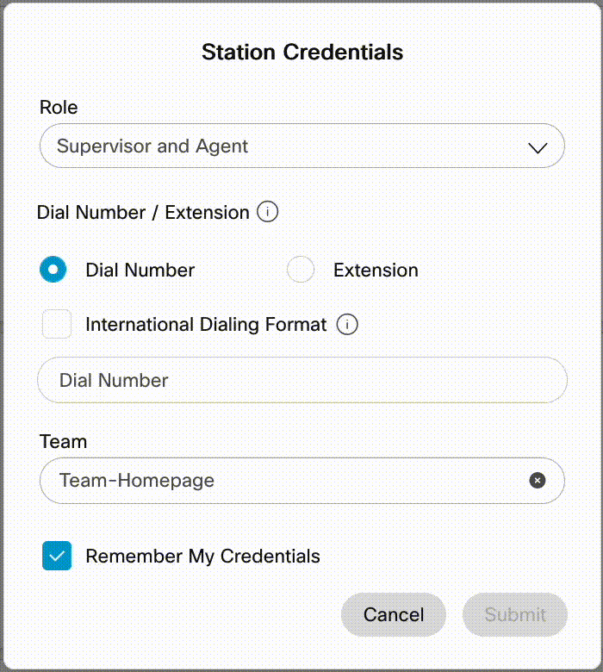
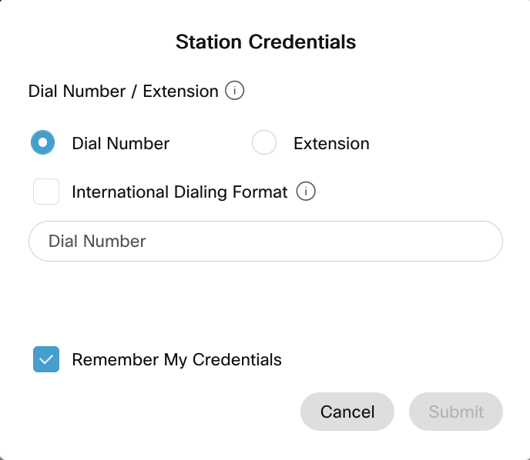
Flexible Sign in options allows supervisor to double up as an agent
1. Dual Role Agent & Supervisor role
Supervisor
Supervisor & Agent
2. Supervisor Only + Monitoring
No Team assigned for agent capabilities
Supervisor gets no role selector
3. Supervisor Only + No Monitoring
No Team assigned for agent capabilities
No Station Sign in option
No Role Selector
Directly lands at Supervisor Desktop when CI sign in is completed
Notes:
WebRTC highlight that it’s coming

Slide 24
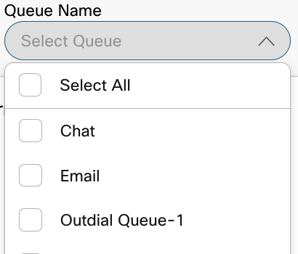
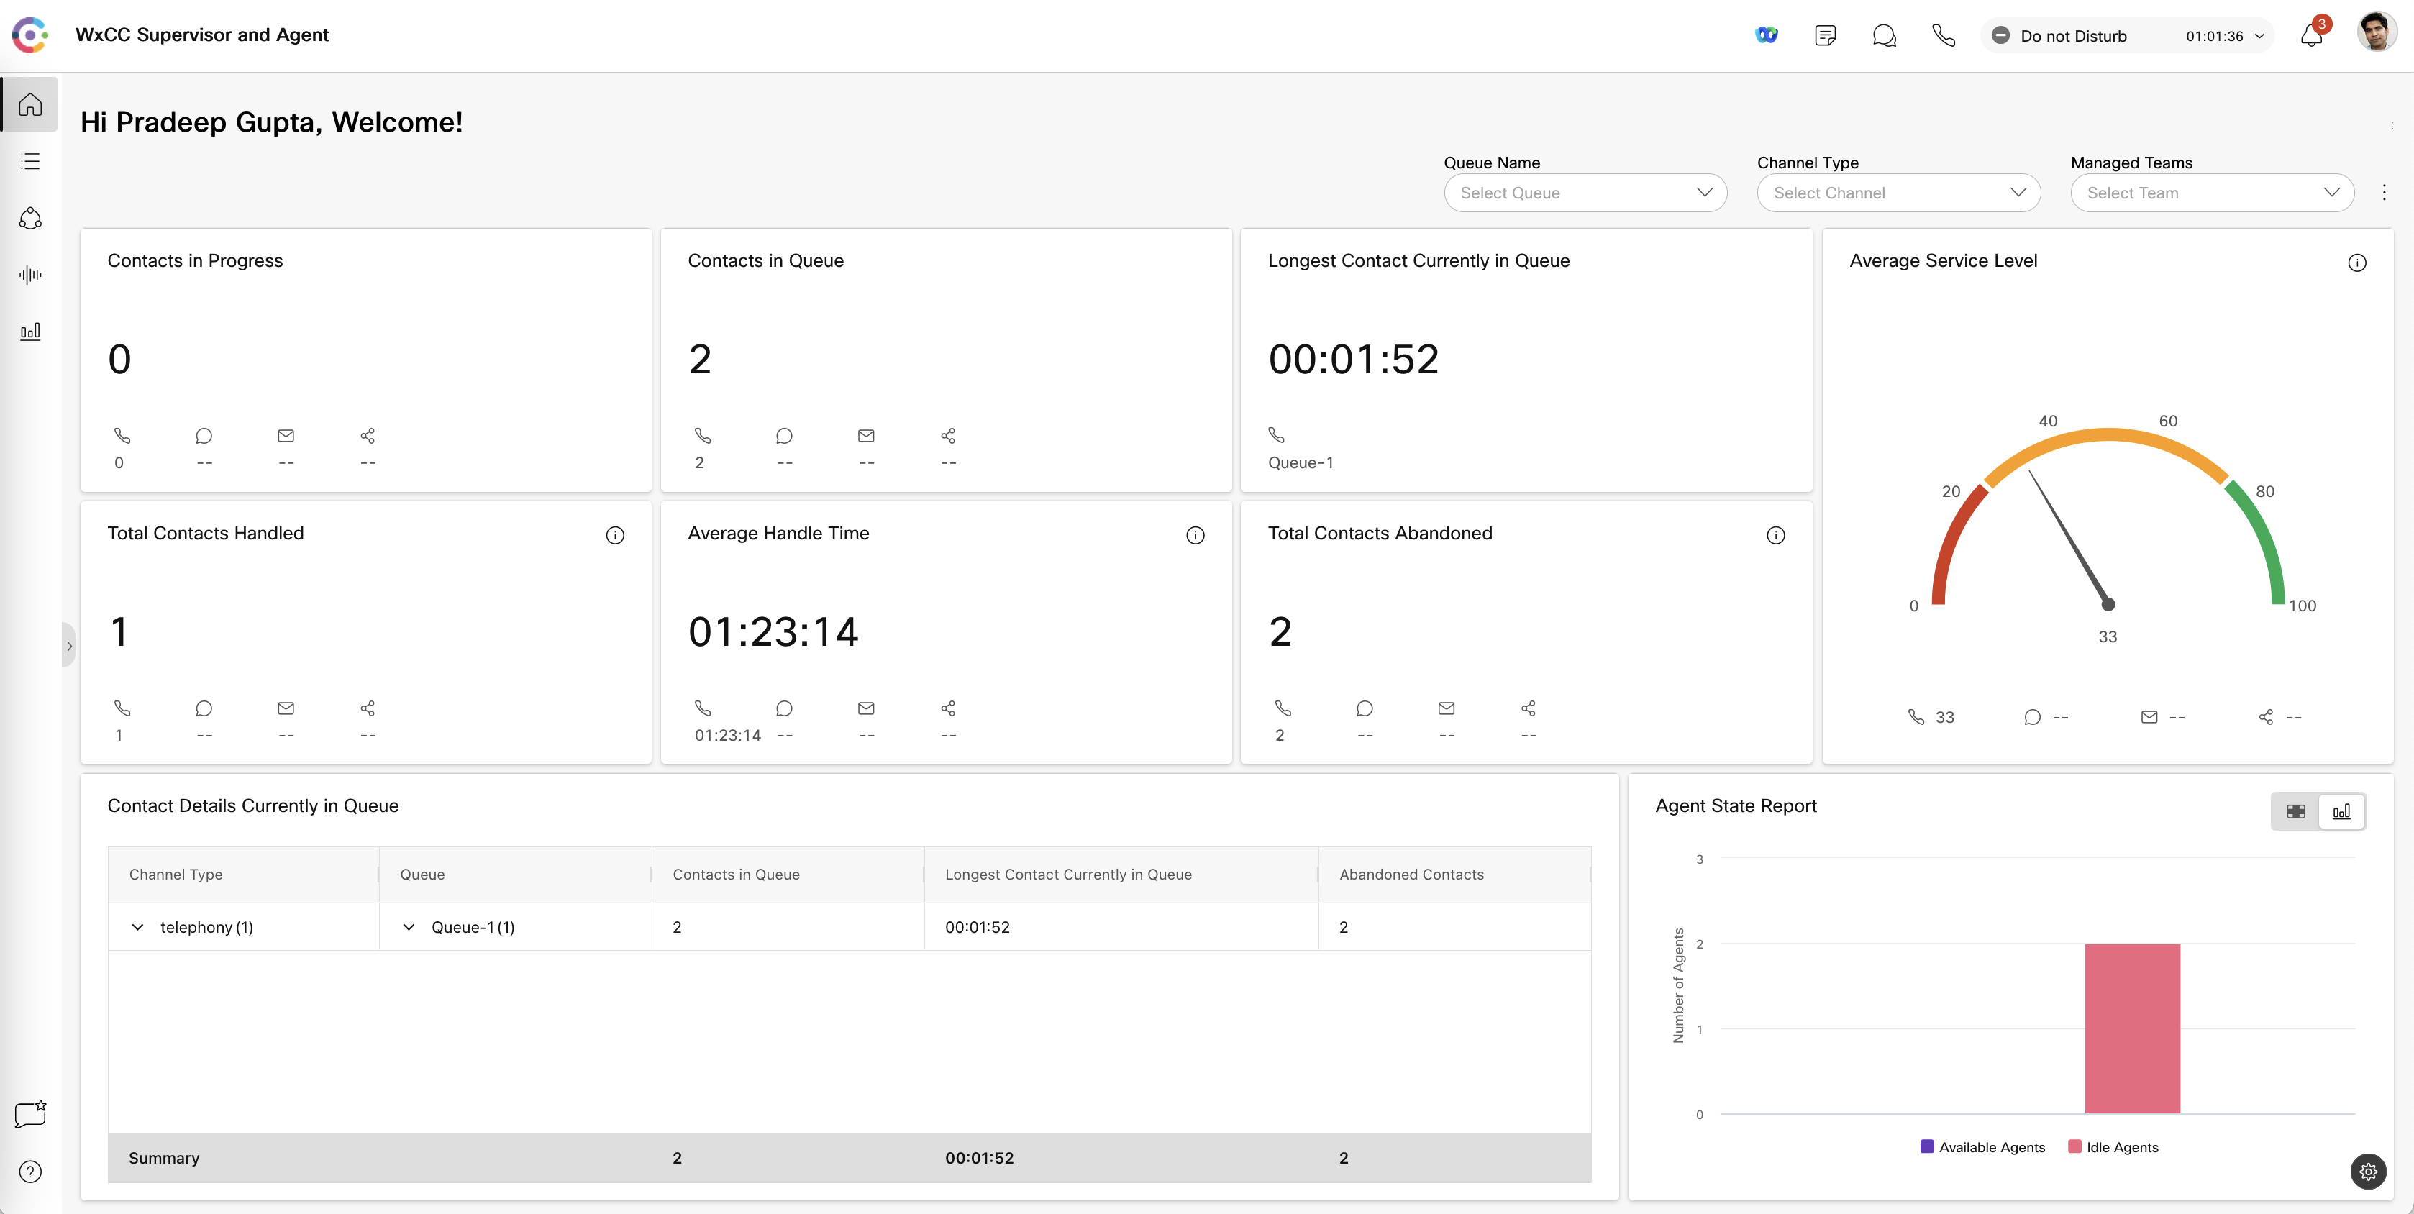
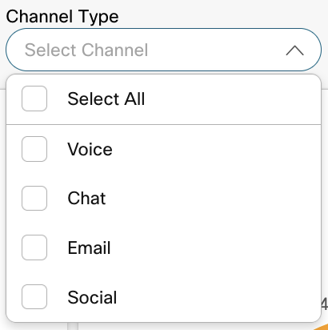
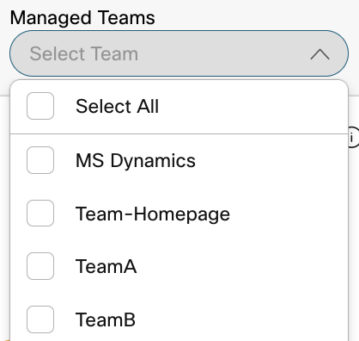
Realtime queue data enables real-time decision making regarding Contact Center SLAs

Slide 25
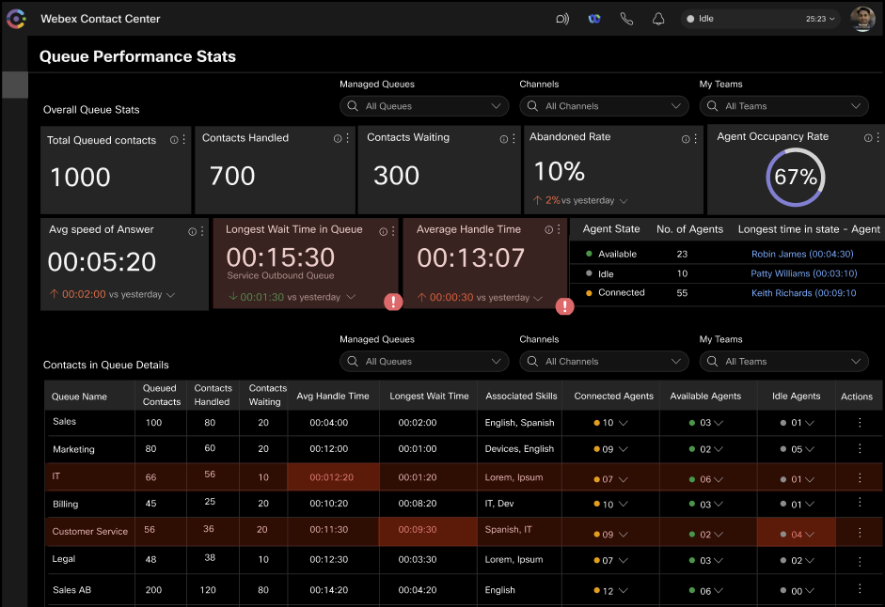
Realtime queue data enables real-time decision making regarding Contact Center SLAs
*Concept – Seeking inputs

Slide 26
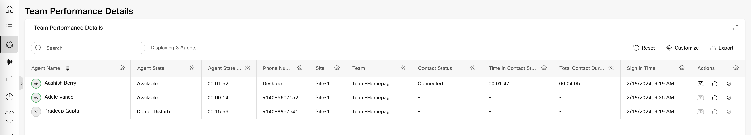
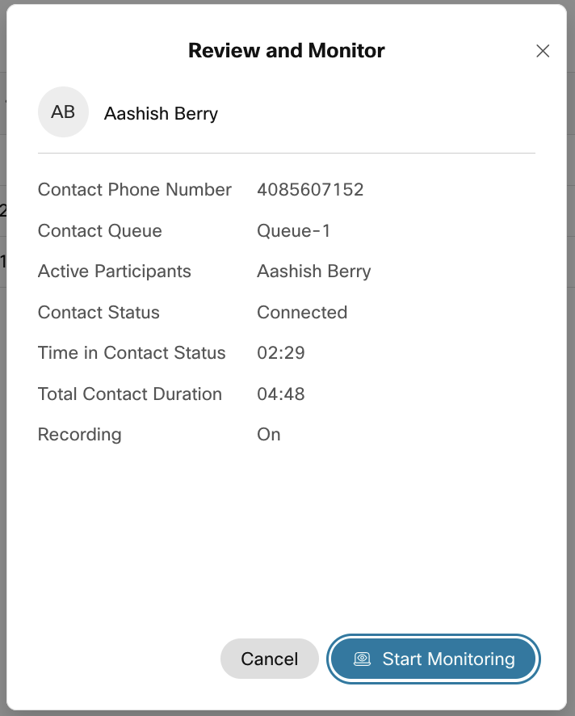
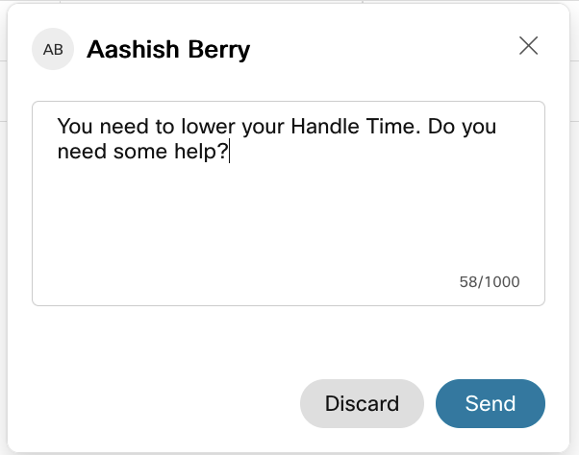
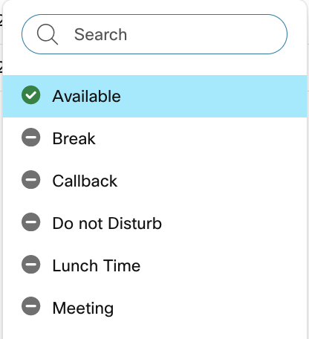
Real time agent data helps supervisors empower agents with the help they need
z
Notes:
- Talk about whisper coaching, banners and how should you approach

Slide 27
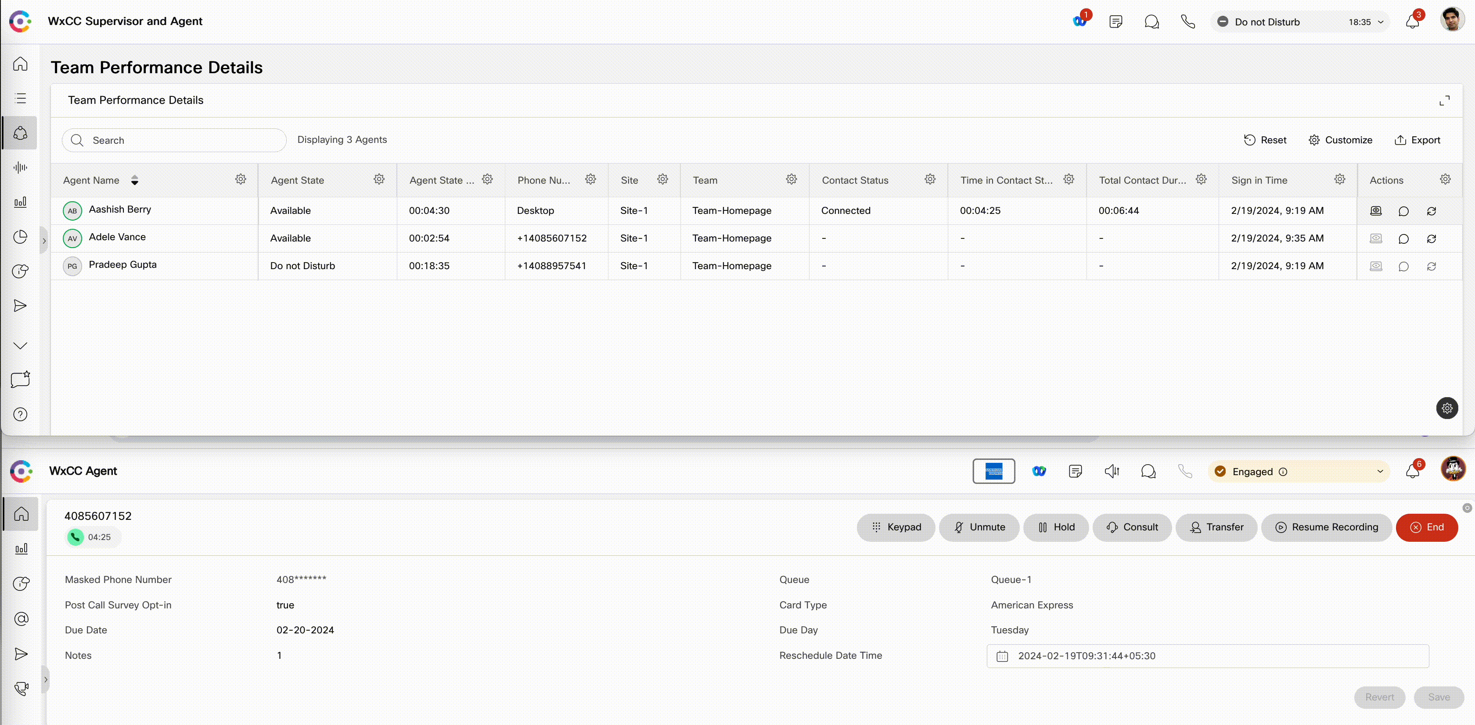
Perform real-time monitoring to identify coaching moments

Slide 28
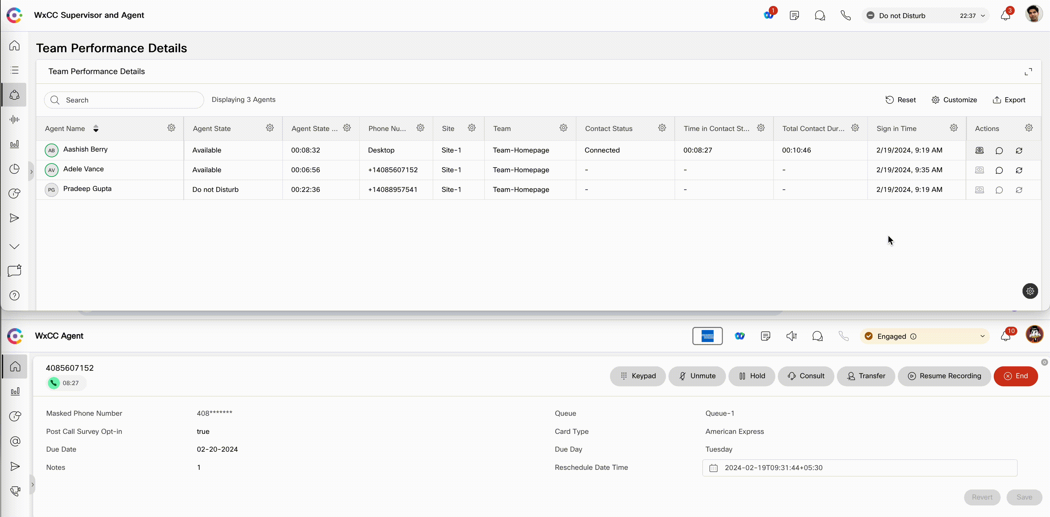
Barge into conversations to help customers

Slide 29
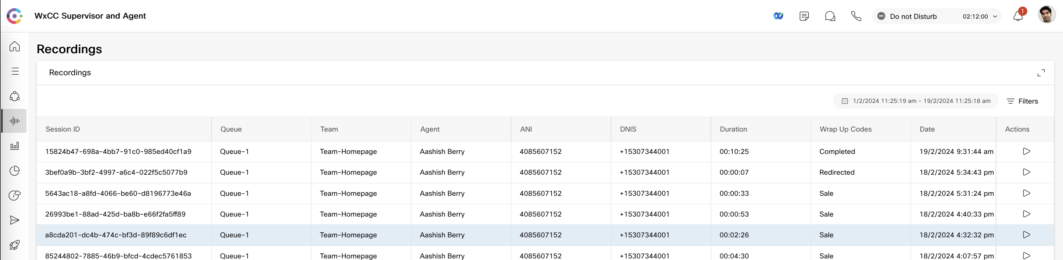
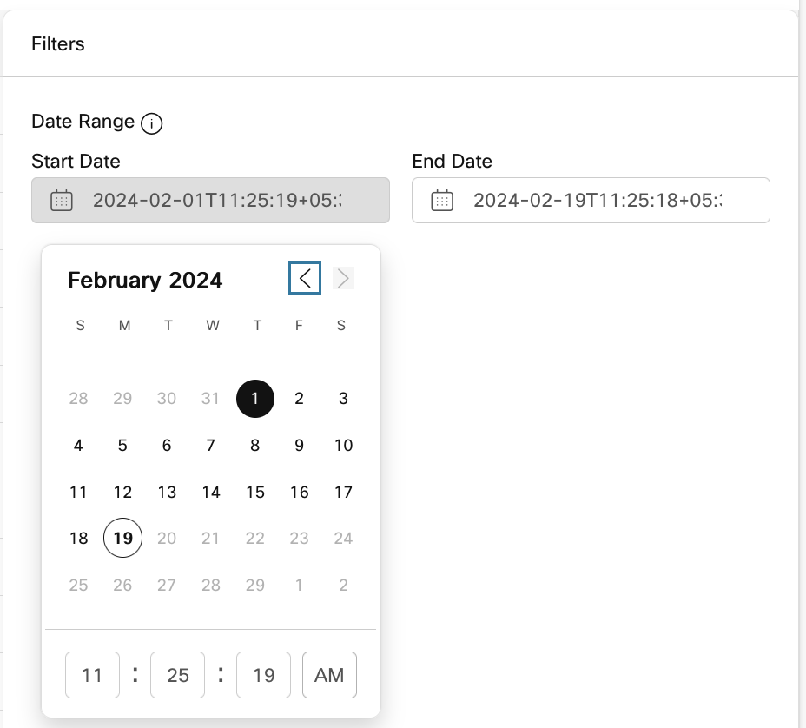
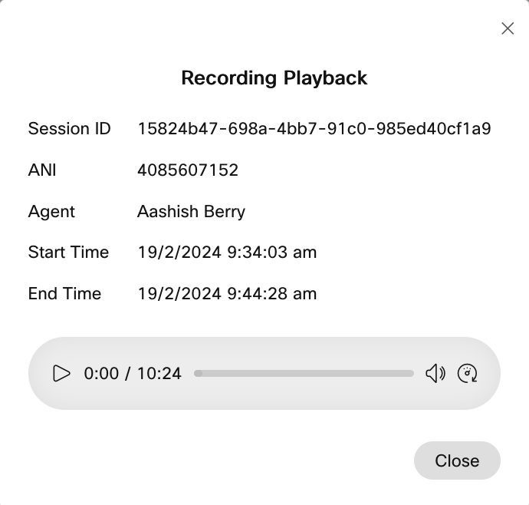
Post Interaction Insights
Supervisors can filter recordings based on a date & time range (no more than 30 days).
Review and Playback call recordings from Supervisor Desktop for agent analysis and training.
Recording Management module should be enabled for the supervisor profile
Notes:
All listed recordings are paginated. Recordings show up as supervisor scrolls through the list.

Slide 30
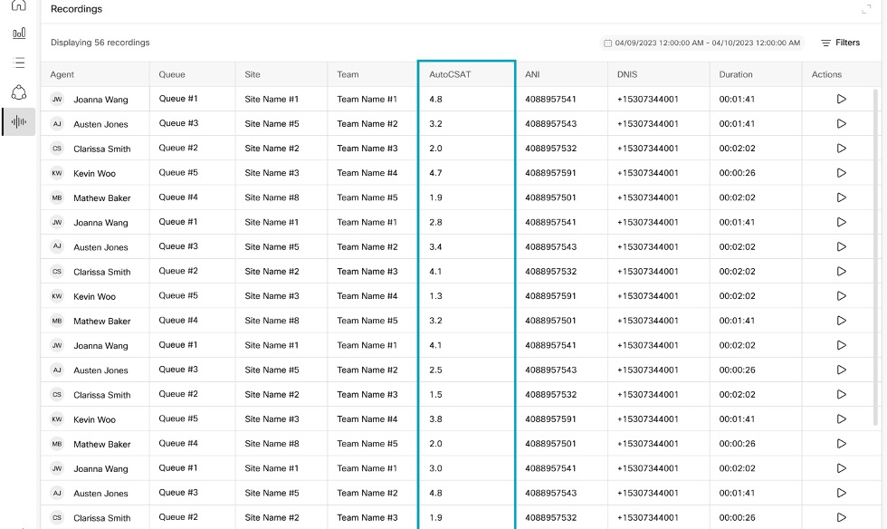
Predict CSAT for Customer Interactions
Auto CSAT* insights can be leveraged to power a number of use cases including:
Identifying areas of improvements for business operations
Timely & proactive loop closure with unhappy customers
Identifying coaching & training needs for agents
Identifying best practices
Orchestrating actions like CSAT based routing
Identifying calls that need to be audited
*In beta now

Slide 31
What agents need to create exceptional customer experiences?
Empowering tools
Supervisors who support them
Care for their own well-being

Slide 32

Agent burnout
CSAT, NPS
87%
50%
of agents report burnout
of turnover attributed to burnout
Productivity
Notes:
Contact center agent's jobs are inherently stressful.
Imagine handling several customer issues across multiple channels, meeting performance targets, all while ensuring customer satisfaction levels remain high.
This puts them at an even higher risk of burnout than the average employee. Data shows 52% of contact center agents are currently facing burnout.
Even worse than that - burnout has been attributed as the cause of 50% (or more) of employee turnover in some organizations.

Slide 33
BEFORE: Agent burnout business impact
25%
2%
Increase in average handle time (AHT)
Drop in Customer Satisfaction (AutoCSAT)
2x
27%
more holds than usual
more time spent on call wrap ups
Notes:
We launched a pilot study with our customer FHB and measured the impact of burnout on agents and customer experiences firsthand. Jason and his entire organization take pride in delivering best experiences to their customers and also taking care of their employees. We will hear from Jason in a bit.

Slide 34
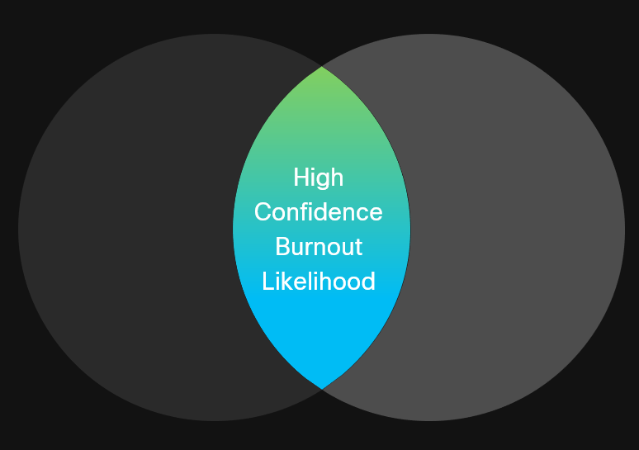
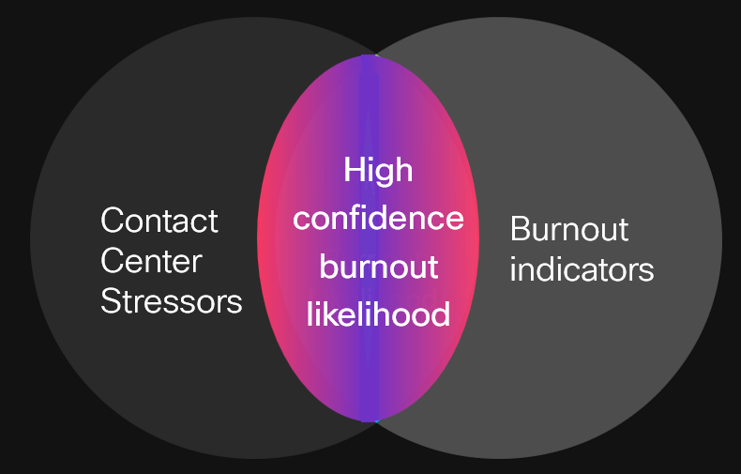
Agent wellness for the future
Proprietary AI-powered agent burnout detection and mitigation
Listen
Detect
Act
Ingest platform data and intelligently surface data from vast resources.
Real-time coaching and automated actions before and during interactions to support agents
Contact Center Stressors
Burnout indicators
Proactive and Automated
APIs for partner integrations

Slide 35
Enable automated actions to mitigate impact of burnout
Real time insights
Real time burnout insights
Before call actions
Call routing, Omnichannel allocation, Breaks, Schedule adjustments, Shift bidding, Thrive reset
Before call actions
During call actions
Burnout insights
During call actions
Whisper coaching, Get help tool
Historic insights
Periodic reports with insights, trends and recommended corrective measures
Notes:
Discuss few actions, APIs, partners role and highlight Thrive partnership

Slide 36

AFTER: Trial results show timely breaks reduce impact of burnout
4x
Improvement in average handle time (AHT)
13%
4.8 to 4.9
Customer Satisfaction Score increase
Decrease in reported agent burnout levels
Powered by AI
Notes:
Comparing performance when break was given vs when break was not given after high burnout level
4 minute call -> burnout -> 5 minute call
Break was not given ->4.9
Break given ->4.6
.1 Vs .4
Delta is 4X when action taken Vs action not taken

Slide 37




Timely Wellness Breaks
Beta Q1CY2024
Customer sentiment, satisfaction scores, and agent performance are monitored in real time to spot signs of a struggling agent and provide them a timely reset.
Dylan has had 4 difficult calls in a row, burnout level crossed threshold and call time has increased 14%
Enjoy your break!
Need to unwind?
Take a breather
AI Assistant

Slide 38

Call to Action!
Very big thank you for attending, partnering and collaborating with us on the Contact Center!
Reach out to Padmini Krishnan for betas on AI features.
Reach out to Janani Ramakrishnan for betas on Supervisor and Agent features (as well as any questions on the personas)
Keep tabs on What’s New for Agents and What’s New for Supervisors
Learn more and sign-up for AI features Beta on https://gobeta.webex.com/welcome/

Slide 39
Backup

Slide 40
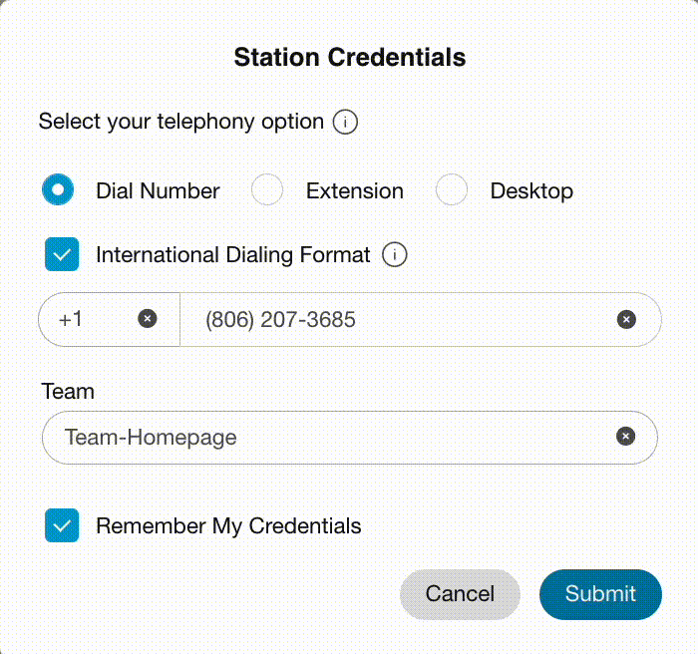
Agent Desktop Station Sign In
Unified Sign in URL and role-based identifications for both agents and supervisors
https://desktop.wxcc-eu1.cisco.com/
Telephony choice based on dynamic preferences
Dial Number – IDD or E164 dialing for PSTN, or on-prem CUCM extensions
Extension – Webex Calling
*Desktop – WebRTC as calling capability (for enabled orgs)
Remember Credentials to preserve choices for subsequent sign-ins – Reduce time & effort
Other DCs – eu2, us1, ca1, anz1, jp1

Slide 41





States
Login
Idle: Signed in, but not ready to accept any requests. This is the default state upon sign-in.
Available: Ready to accept and respond to contact incoming requests.
Engaged: When the contact request is accepted, the status changes from Available to Engaged (Available). Agent can accept additional requests until the Channel Capacity is reached. If agent don’t want to receive more requests, he can select any Idle code and he will be moved to Engaged (Idle) state.
RONA (Redirection on No Answer): Agent has not accepted a request within specified time. The request is returned to the queue and system changes the state from Available to RONA. Agent can decide Go To Idle or Available after RONA
Idle
Available
Ringing
Engaged (Available)
Engaged (Idle)
End Call
Wrap-Up
RONA

